Slide 1


Overview of Generative Models II
张江
北京师范大学系统科学学院教授
集智俱乐部、集智学园创始人
集智研究中心理事长
更多“人工智能 & 复杂系统”的知识，请关注官网：campus.swarma.org
Notes:
封面

Slide 2
Generative Model Zoo
https://lilianweng.github.io/posts/2021-07-11-diffusion-models/

Slide 3
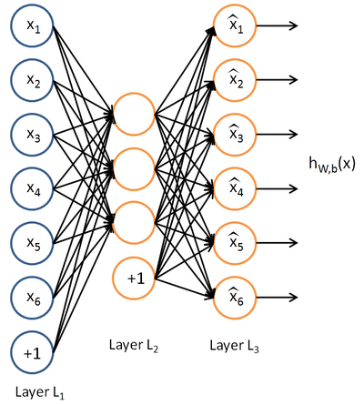
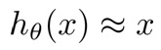
Autoencoder
Unsupervised learning
Feed-back
Reconstruct input:
BP Learning
Constraints
更多“人工智能 & 复杂系统”的知识，请关注官网：campus.swarma.org

Slide 4
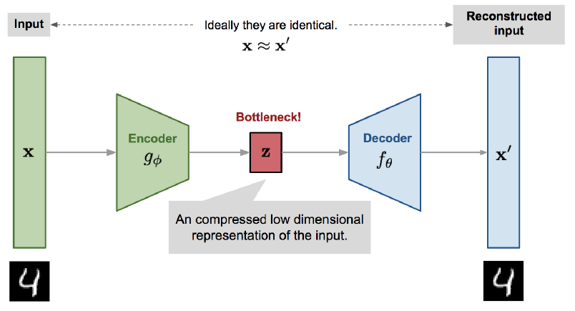
Variational Auto Encoder
https://lilianweng.github.io/posts/2018-08-12-vae/

Slide 5
What is the Difference
https://lilianweng.github.io/posts/2018-08-12-vae/

Slide 6
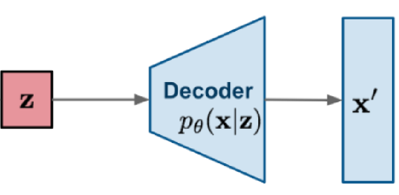
Latent Variable
更多“人工智能 & 复杂系统”的知识，请关注官网：campus.swarma.org

Slide 7
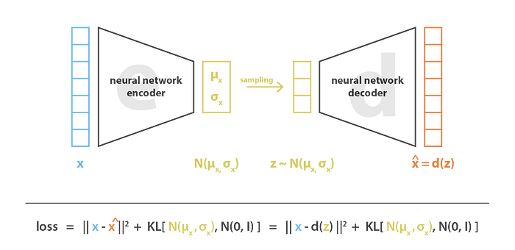
How to design loss function?
ELBO
更多“人工智能 & 复杂系统”的知识，请关注官网：campus.swarma.org

Slide 8
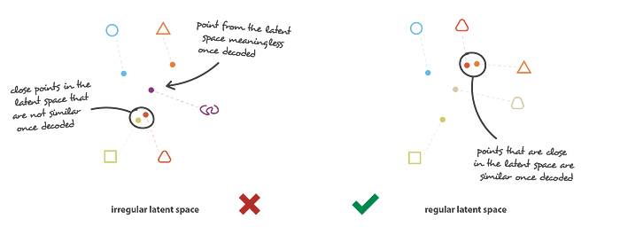
How to design loss function?
Two important requirements:
Continuity
Completeness
更多“人工智能 & 复杂系统”的知识，请关注官网：campus.swarma.org

Slide 9
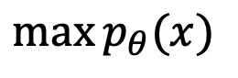
Maximum Likelihood Principle
$$\max{p_{θ}(x)}$$
更多“人工智能 & 复杂系统”的知识，请关注官网：campus.swarma.org

Slide 10
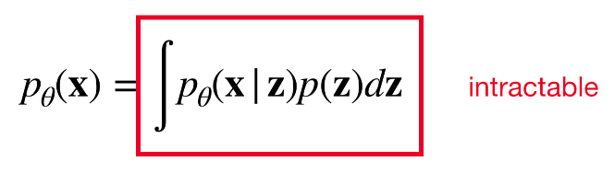
Maximum Likelihood Principle
$$\max{p_{θ}(x)}$$
更多“人工智能 & 复杂系统”的知识，请关注官网：campus.swarma.org

Slide 11
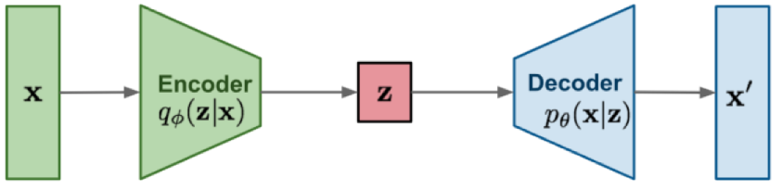
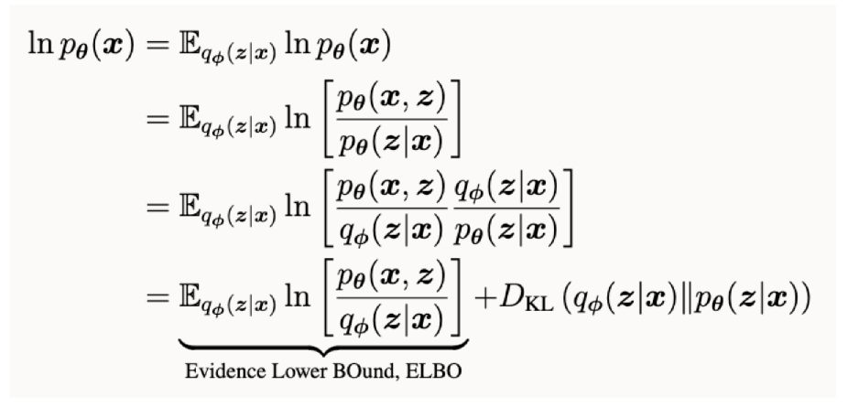
Variation
Variational Distribution
更多“人工智能 & 复杂系统”的知识，请关注官网：campus.swarma.org

Slide 12
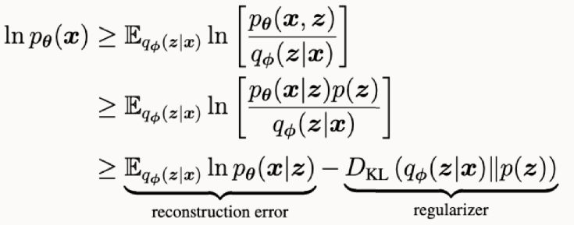
Variation
更多“人工智能 & 复杂系统”的知识，请关注官网：campus.swarma.org

Slide 13
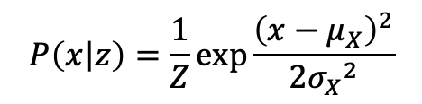
Latent Variable as Gaussian
$$P\left(x | z\right)=\frac{1}{Z}\exp{\frac{{\left(x−μ_{X}\right)}^{2}}{2{σ_{X}}^{2}}}$$
更多“人工智能 & 复杂系统”的知识，请关注官网：campus.swarma.org

Slide 14
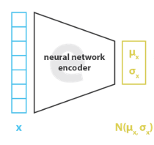
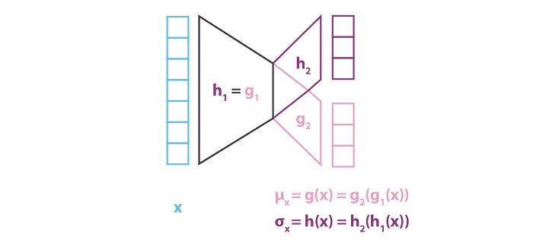
How to generate random noise?
更多“人工智能 & 复杂系统”的知识，请关注官网：campus.swarma.org

Slide 15
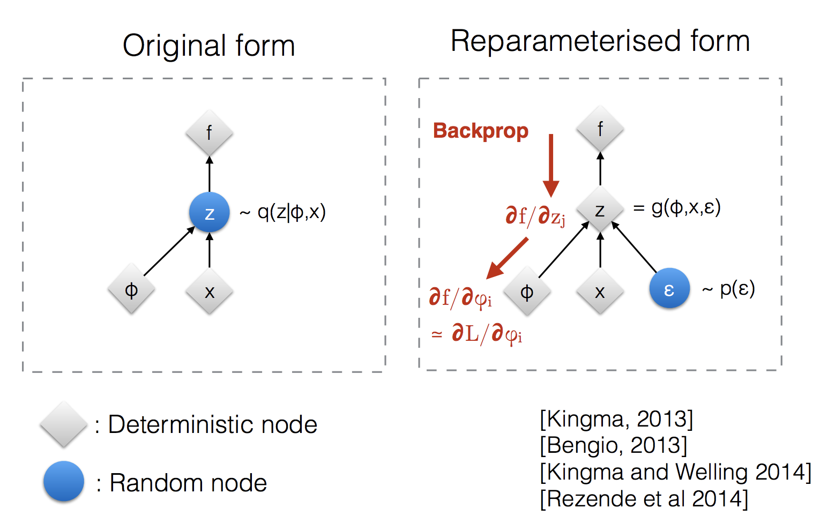
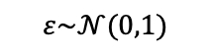
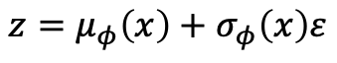
Reparameter Technique
$$z=μ_{φ}\left(x\right)+σ_{φ}\left(x\right)ε$$
$$ε\sim 𝒩(0,1)$$
更多“人工智能 & 复杂系统”的知识，请关注官网：campus.swarma.org

Slide 16
Results
更多“人工智能 & 复杂系统”的知识，请关注官网：campus.swarma.org

Slide 17
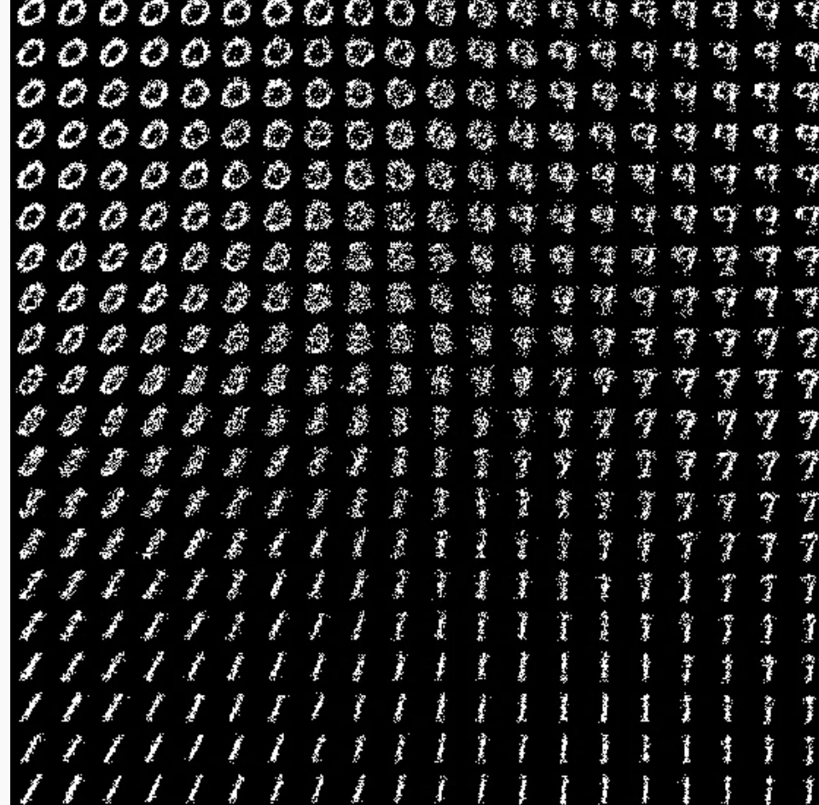
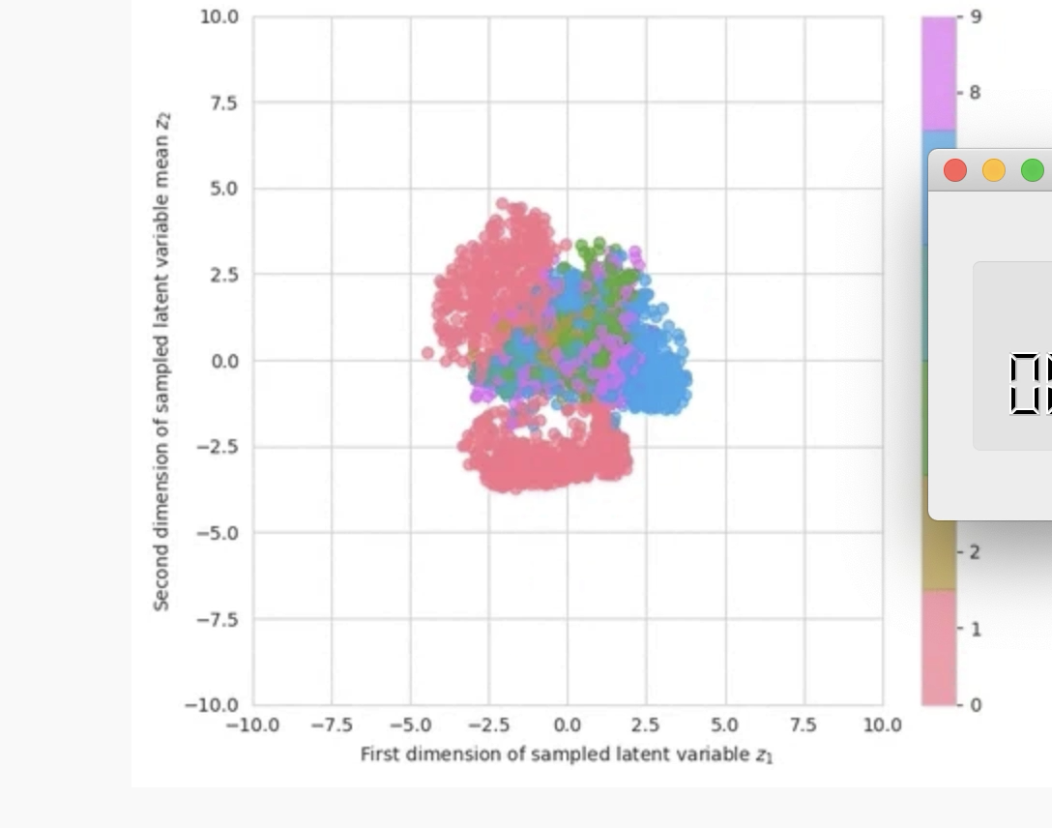
Results
更多“人工智能 & 复杂系统”的知识，请关注官网：campus.swarma.org

Slide 18
VAE的优缺点
优点：
生成高质量的样本。
自动编码器
潜在空间
变分推断
应用广泛
缺点：
训练困难：VAE的训练过程比较困难，需要设置合适的超参数和优化算法，避免出现梯度消失和模式崩溃的问题。
模型复杂：VAE的模型比较复杂，需要大量的计算资源和时间来训练。
生成样本有限：VAE生成的样本数量是有限的，因为它只能从潜在空间中采样有限的样本。
模糊的潜在空间：VAE学习的潜在空间可能是模糊的，因为它只是对数据的一个近似表示，可能存在信息损失。
更多“人工智能 & 复杂系统”的知识，请关注官网：campus.swarma.org

Slide 19
Generative Model Zoo
https://lilianweng.github.io/posts/2021-07-11-diffusion-models/

Slide 20
Normalizing Flow
For finite discrete variable
Softmax function
For continuous with gaussian distribution
VAE
For continuous with any distribution
Normalizing Flow
Diffusion model
更多“人工智能 & 复杂系统”的知识，请关注官网：campus.swarma.org

Slide 21
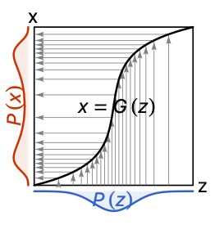
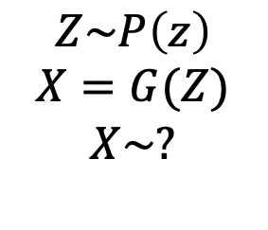
Density function of inverse function
$$Z\sim P\left(z\right)$$
$$X=G(Z)$$
$$X\sim ?$$
G is a bijector
更多“人工智能 & 复杂系统”的知识，请关注官网：campus.swarma.org

Slide 22
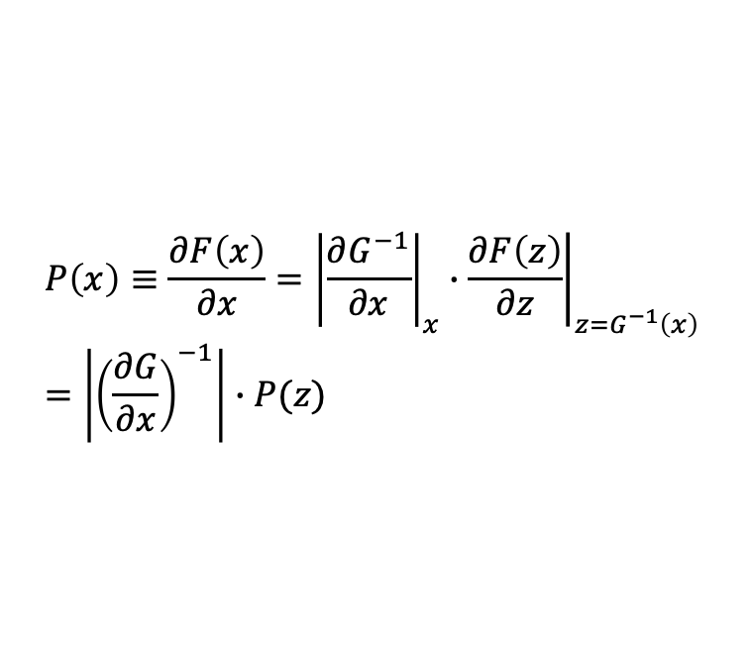
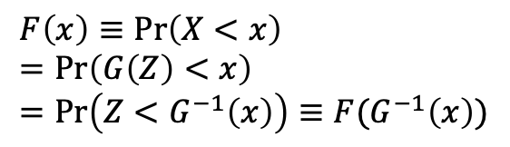
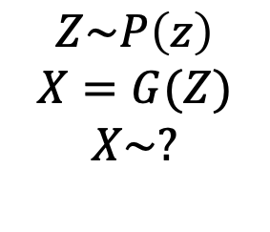
Density function of inverse function
$$Z\sim P\left(z\right)$$
$$X=G(Z)$$
$$X\sim ?$$
$$F\left(x\right)≡\operatorname{Pr}\left(X<x\right)=\operatorname{Pr}\left(G\left(Z\right)<x\right)=\operatorname{Pr}\left(Z<G^{−1}\left(x\right)\right)≡F(G^{−1}\left(x\right))$$
$$P\left(x\right)≡\frac{∂F\left(x\right)}{∂x}={\left|\frac{∂G^{−1}}{∂x}\right|}_{x}∙{\left.\frac{∂F\left(z\right)}{∂z}\right|}_{z=G^{−1}\left(x\right)}=\left|{\left(\frac{∂G}{∂x}\right)}^{−1}\right|∙P(z)$$
更多“人工智能 & 复杂系统”的知识，请关注官网：campus.swarma.org

Slide 23
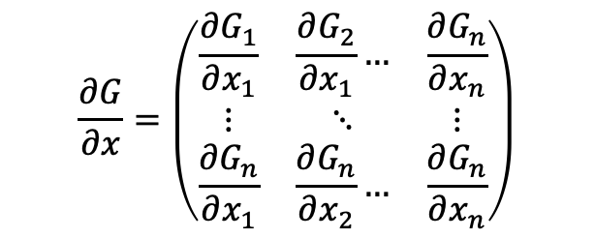
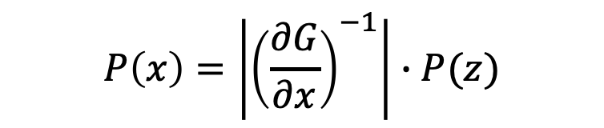
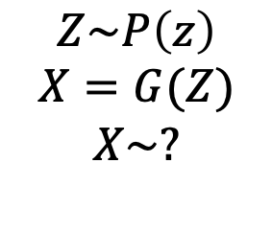

For general case
$$Z\sim P\left(z\right)$$
$$X=G(Z)$$
$$X\sim ?$$
$$P\left(x\right)=\left|{\left(\frac{∂G}{∂x}\right)}^{−1}\right|∙P(z)$$
Jacobian:
$$x,z∈ℜ^{n}$$
$$\frac{∂G}{∂x}=\left(\begin{matrix}\frac{∂G_{1}}{∂x_{1}} & \frac{∂G_{2}}{∂x_{1}}… & \frac{∂G_{n}}{∂x_{n}} \\ ⋮ & ⋱ & ⋮ \\ \frac{∂G_{n}}{∂x_{1}} & \frac{∂G_{n}}{∂x_{2}}… & \frac{∂G_{n}}{∂x_{n}}\end{matrix}\right)$$
$$\left|x\right|:abusolute value of determinant$$
更多“人工智能 & 复杂系统”的知识，请关注官网：campus.swarma.org

Slide 24
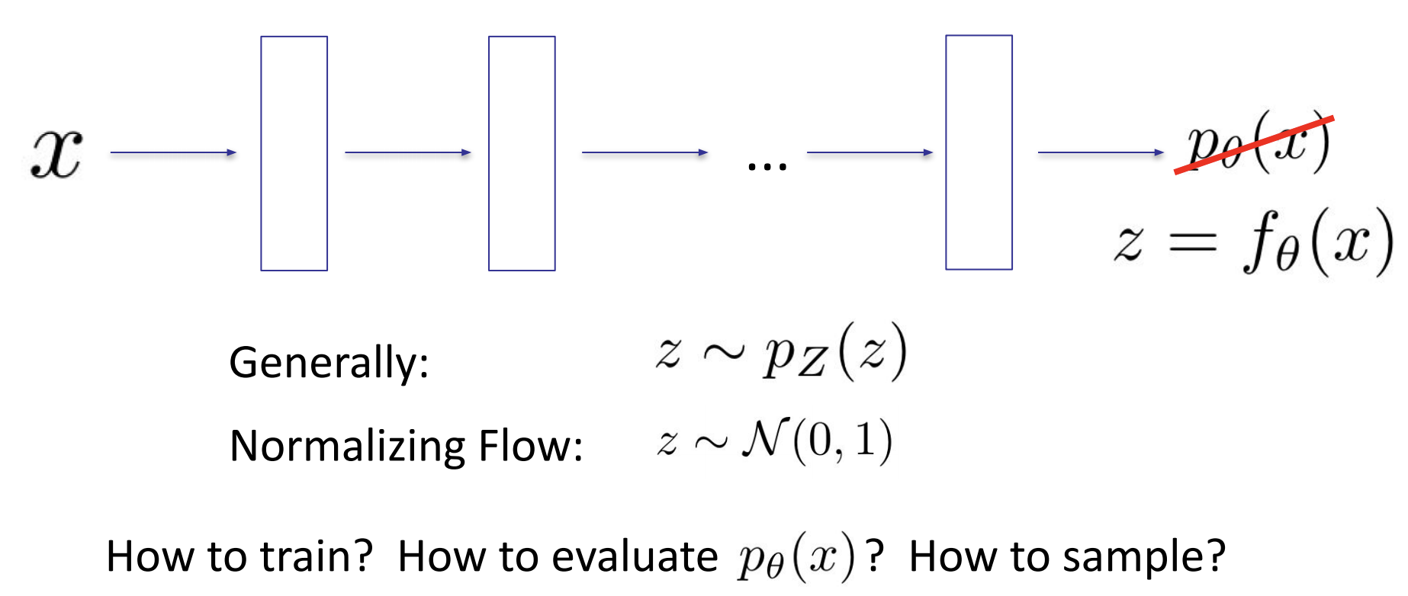
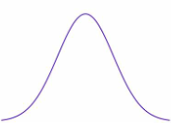

Flows: main idea
Invertible function
Invertible function
Invertible function
UC Berkeley -- Spring 2020 -- Deep Unsupervised Learning -- Pieter Abbeel, Peter Chen, Jonathan Ho, Aravind Srinivas, Alex Li, Wilson Yan -- L3 Flows

Slide 25
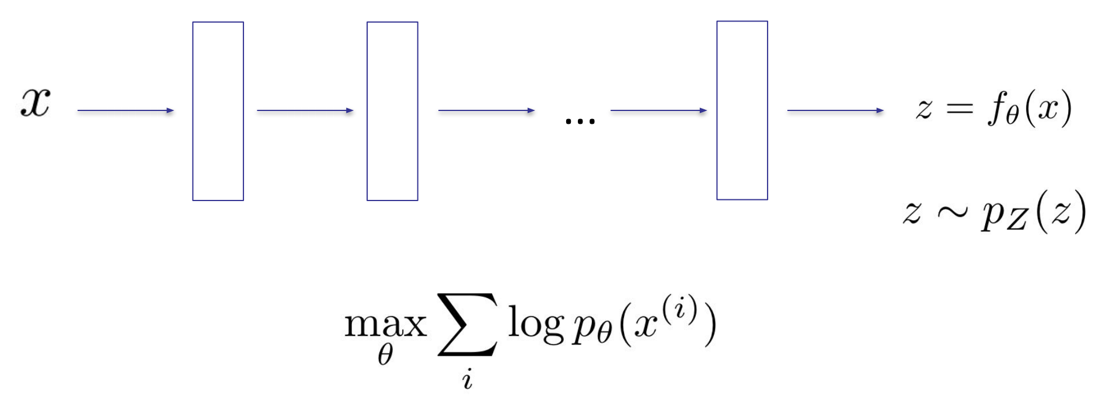
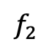
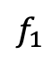
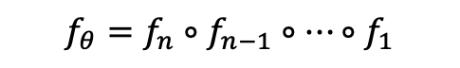
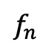
Flows: main idea
$$f_{θ}=f_{n}∘f_{n−1}∘…∘f_{1}$$
Invertible function
Invertible function
Invertible function
$$f_{1}$$
$$f_{2}$$
$$f_{n}$$
UC Berkeley -- Spring 2020 -- Deep Unsupervised Learning -- Pieter Abbeel, Peter Chen, Jonathan Ho, Aravind Srinivas, Alex Li, Wilson Yan -- L3 Flows

Slide 26
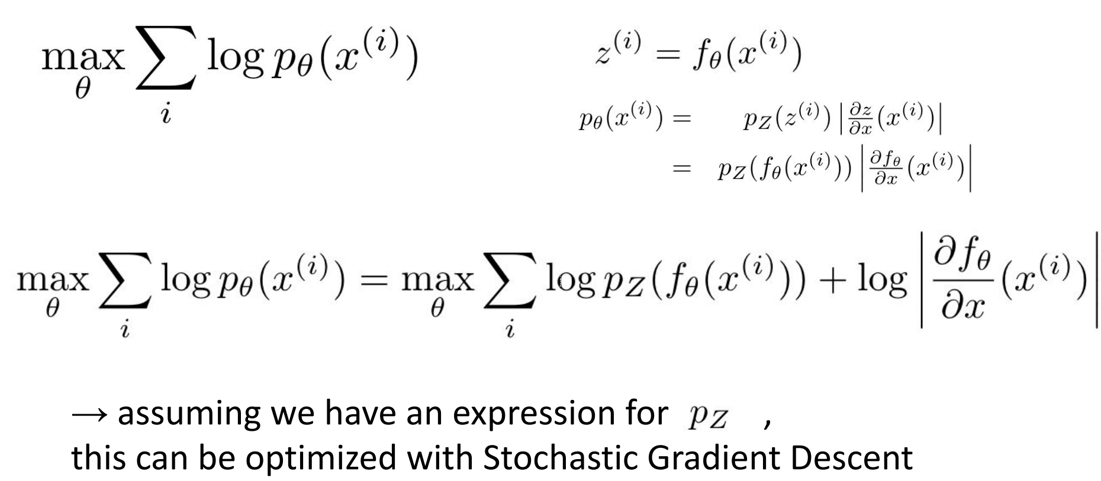
Training
UC Berkeley -- Spring 2020 -- Deep Unsupervised Learning -- Pieter Abbeel, Peter Chen, Jonathan Ho, Aravind Srinivas, Alex Li, Wilson Yan -- L3 Flows

Slide 27
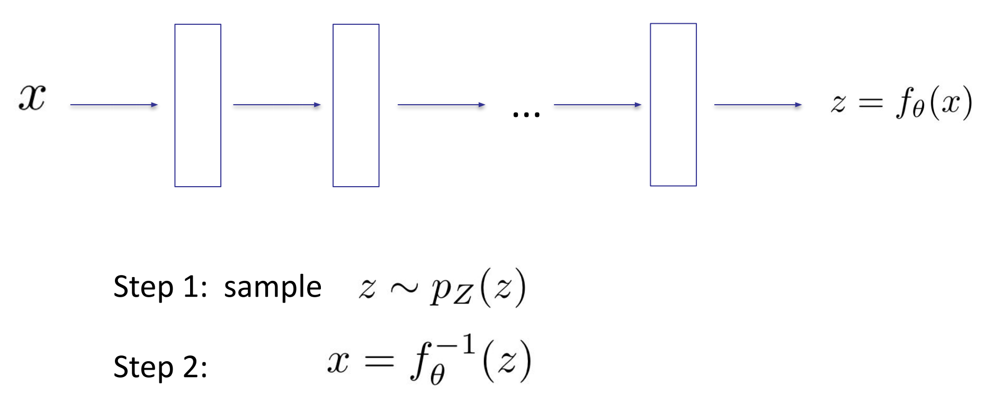
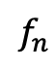
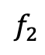
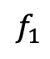
Sampling
$$f_{1}$$
$$f_{2}$$
$$f_{n}$$
UC Berkeley -- Spring 2020 -- Deep Unsupervised Learning -- Pieter Abbeel, Peter Chen, Jonathan Ho, Aravind Srinivas, Alex Li, Wilson Yan -- L3 Flows

Slide 28
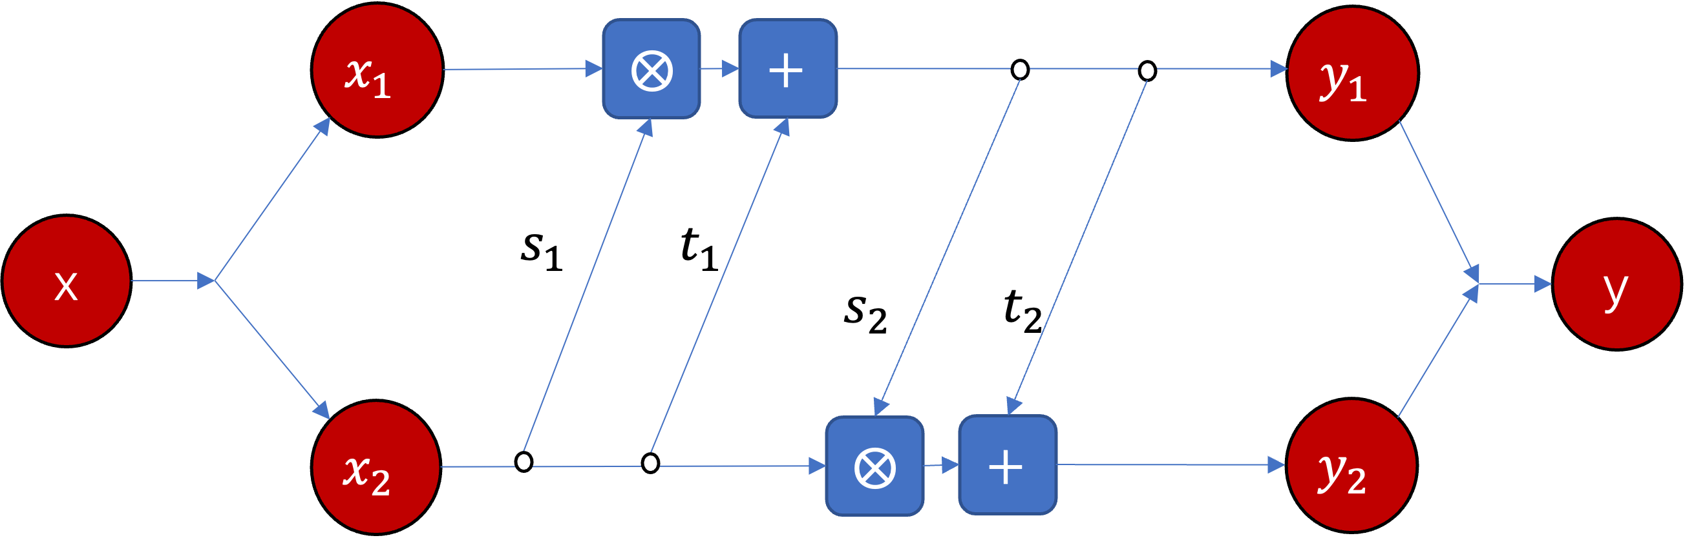

Invertible Neural Network - RealNVP
$$y_{1}=x_{1}⨂\exp\left(s_{1}\left(x_{2}\right)\right)+t_{1}(x_{2})$$
$$y_{2}=x_{2}⨂\exp\left(s_{2}\left(y_{1}\right)\right)+t_{2}\left(y_{1}\right)$$
https://arxiv.org/pdf/1605.08803.pdf，DENSITY ESTIMATION USING REAL NVP

Slide 29
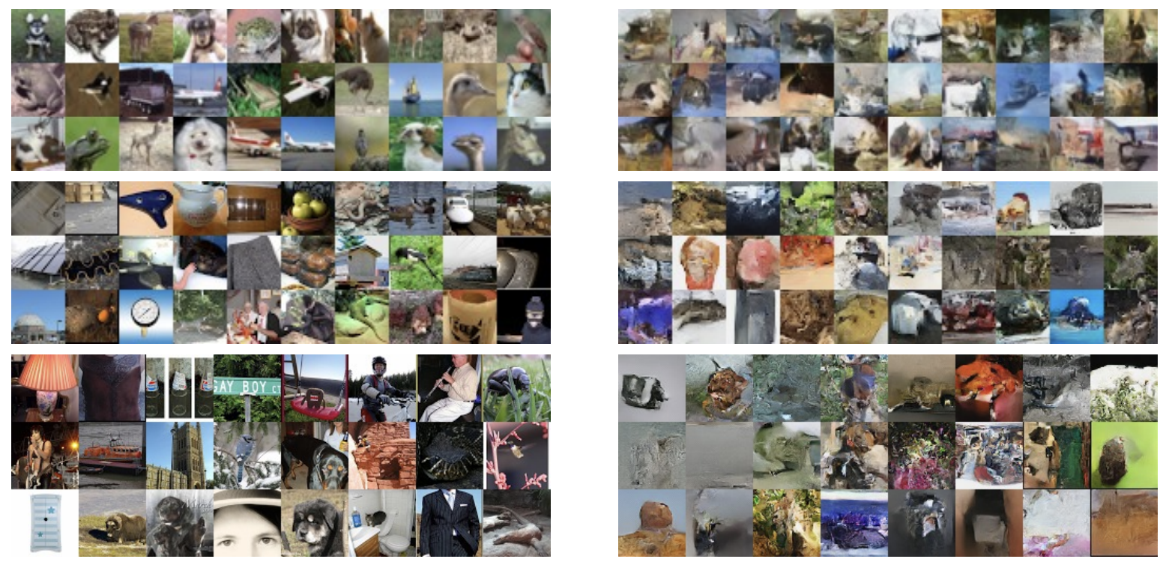
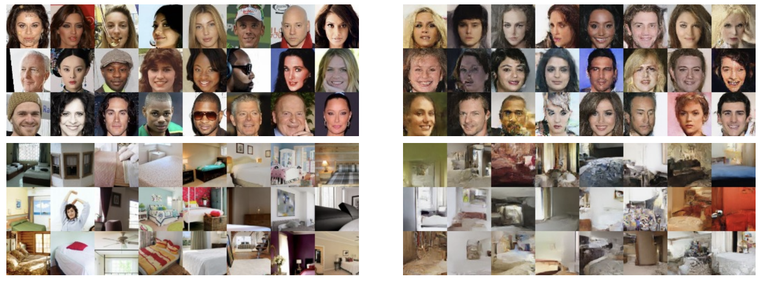
Results
https://arxiv.org/pdf/1605.08803.pdf，DENSITY ESTIMATION USING REAL NVP

Slide 30
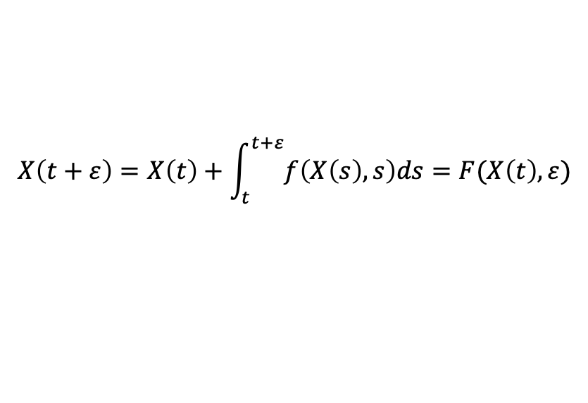
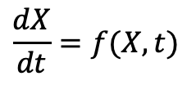
Differential Equation and Flows
X2(t)
P(X(0))
P(X(T))
$$\frac{dX}{dt}=f(X,t)$$
X(T)
$$X\left(t+ε\right)=X\left(t\right)+\int_{t}^{t+ε}{f\left(X\left(s\right),s\right)ds}=F(X\left(t\right),ε)$$
X1(t)
https://arxiv.org/pdf/1605.08803.pdf，DENSITY ESTIMATION USING REAL NVP

Slide 31
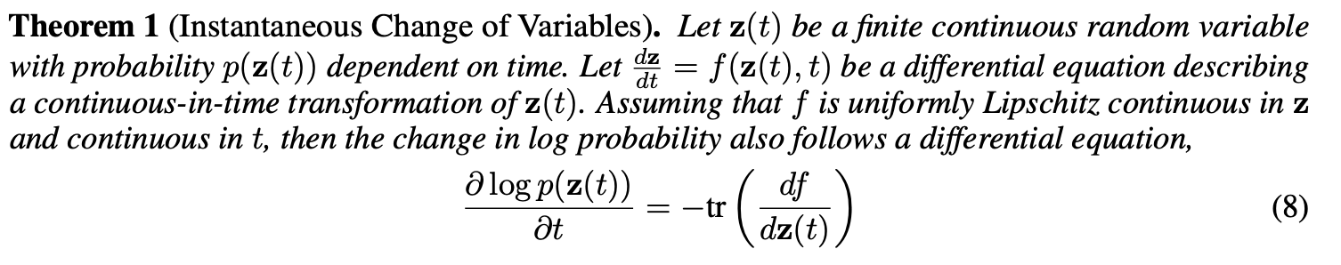
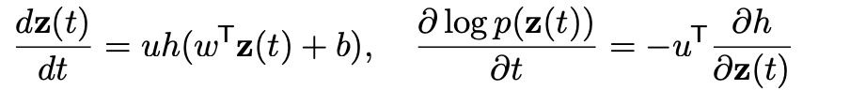
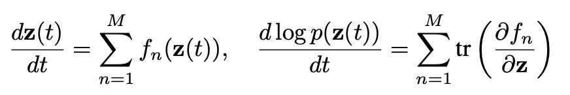
Continuous Normalizing Flows
https://arxiv.org/pdf/1806.07366.pdf，Neural ODE

Slide 32
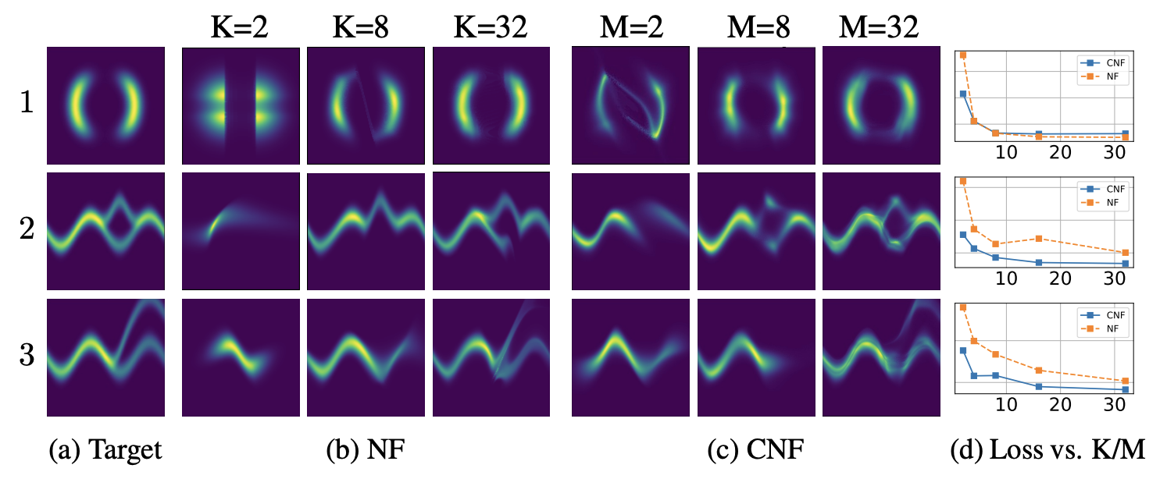
Continuous Normalizing Flows - Results
https://arxiv.org/pdf/1806.07366.pdf，Neural ODE

Slide 33
Normalizing flow的优缺点
优点：
高灵活性：Normalizing flow模型的灵活性很高，可以使用各种变换来构建生成模型，包括仿射变换、非线性变换等，因此可以适用于不同的数据集。
直接可逆：Normalizing flow模型的变换是直接可逆的，因此可以轻松地计算样本的概率密度函数，不需要使用复杂的采样算法。
高效性：Normalizing flow模型的训练过程比较高效，可以使用反向传播算法进行优化，因此可以应用于大规模数据集。
高质量的生成样本：Normalizing flow模型可以生成高质量的样本，这些样本与原始数据非常相似，因此可以应用于图像生成、语音生成等领域。
缺点：
模型复杂：Normalizing flow模型比较复杂，需要使用多层非线性变换来构建生成模型，因此需要更多的计算资源和时间来训练。
变换的选择：Normalizing flow模型的性能很大程度上取决于变换的选择，需要选择合适的变换来构建生成模型，而这个过程比较困难。
模型的可解释性：Normalizing flow模型的可解释性较差，因为它是一种黑盒模型，不容易解释模型中的变换和参数的含义。

Slide 34
Generative Model Zoo
https://lilianweng.github.io/posts/2021-07-11-diffusion-models/

Slide 35
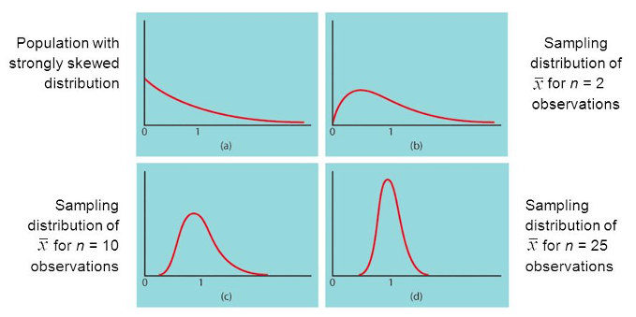
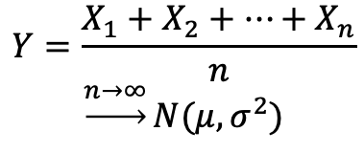
Central Limit Theorem & Diffusion Process
$$Y=\frac{X_{1}+X_{2}+…+X_{n}}{n}$$
$$\underset{→}{n→∞}N(μ,σ^{2})$$
更多“人工智能 & 复杂系统”的知识，请关注官网：campus.swarma.org

Slide 36


Central Limit Theorem & Diffusion Process
更多“人工智能 & 复杂系统”的知识，请关注官网：campus.swarma.org

Slide 37
Diffusion Models
Several diffusion-based generative models
diffusion probabilistic models (Sohl-Dickstein et al., 2015 https://arxiv.org/abs/1503.03585),
noise-conditioned score network (NCSN; Yang & Ermon, 2019 https://arxiv.org/abs/1907.05600),
denoising diffusion probabilistic models (DDPM; Ho et al. 2020 https://arxiv.org/abs/2006.11239).
https://lilianweng.github.io/posts/2021-07-11-diffusion-models/

Slide 38

Diffusion
https://arxiv.org/pdf/1503.03585.pdf

Slide 39

Basic Idea
How can you denoise an image if you have a large amount of image data
https://arxiv.org/pdf/1503.03585.pdf

Slide 40

Basic Idea
https://arxiv.org/pdf/1503.03585.pdf

Slide 41

Score function
https://arxiv.org/pdf/1907.05600.pdf

Slide 42






Score function
$$p_{θ}\left(x\right)=\frac{e^{−f_{θ}^{}(x)}}{Z_{θ}}$$
$Z_{θ}=\int{e^{−f_{θ}^{}(x)}dx}$
intractable
$s_{θ}\left(x\right)$: Score function
https://yang-song.net/blog/2021/score/

Slide 43







Basic Idea
Add noise
$$x\sim p\left(x\right), x+σ_{i}z$$
$$z\sim N(0,I)$$
Learning:
$$s_{θ}(x,i)≃∇_{x}\log{p_{σ_{i}}(x)}$$
For i=1,2,…L
Objective:
https://yang-song.net/blog/2021/score/

Slide 44




How to estimate gradient of likelihood?
$$L_{i}=\int_{x∈ℝ^{n}}{p_{σ_{i}}(x){\left\|s_{θ}\left(x,i\right)−ψ(x)\right\|}^{2}}dx$$
$$ψ\left(x\right)=∇_{x}\log{p_{σ_{i}}(x)}$$
It can be proved:
$$L_{i}=\int_{x∈ℝ^{n}}{p_{σ_{i}}(x)\sum_{j=1}^{n}{\left[∂_{j}s_{θ,j}\left(x\right)+\frac{1}{2}s_{θ,j}\left(x\right)\right]}}dx+c$$
https://www.cs.helsinki.fi/u/ahyvarin/papers/JMLR05.pdf

Slide 45


How to model score function?
https://arxiv.org/pdf/1505.04597.pdf

Slide 46

Stochastic Differential Equation
https://yang-song.net/blog/2021/score/

Slide 47


Stochastic Differential Equation
https://yang-song.net/blog/2021/score/

Slide 48


Results
https://yang-song.net/blog/2021/score/

Slide 49

DDPM
https://arxiv.org/pdf/2006.11239.pdf

Slide 50















Forward: Diffusion Process
Forward
$$+Y_{1}$$
$$+Y_{2}$$
$$+Y_{3}$$
$$+Y_{T}$$
$$X_{0}$$
$$X_{1}$$
$$X_{2}$$
$$X_{T}$$
$${Z=X}_{T}$$
$$−{\tilde{Y}}_{1}$$
$$−{\tilde{Y}}_{2}$$
$$−{\tilde{Y}}_{3}$$
$$−{\tilde{Y}}_{T}$$
Backward
https://lilianweng.github.io/posts/2021-07-11-diffusion-models/

Slide 51












Forward: Diffusion Process
$$+Y_{1}\sim 𝒩(μ_{1},Σ_{1})$$
$$+Y_{2}\sim 𝒩(μ_{2},Σ_{2})$$
$$+Y_{T}\sim 𝒩(μ_{T},Σ_{T})$$
$$X_{0}$$
$$X_{1}$$
$$X_{2}$$
$$X_{T}$$
$${Z=X}_{T}$$
Diffusion
Diffusion
Diffusion
$$μ_{t}=(\sqrt{β_{t}}−1)X_{t−1},$$
$$Σ_{t}=β_{t}I$$
$$β_{t}∈(0,1)$$
$$\sqrt{β_{t}}$$
$$X_{t−1}$$
https://lilianweng.github.io/posts/2021-07-11-diffusion-models/
Jonathan Ho, Ajay Jain, and Pieter Abbeel. “Denoising diffusion probabilistic models”. In: Advances in Neural Information Processing Systems 33 (2020), pp. 6840–6851.

Slide 52




Forward: Central Limit Theorem
$$+Y_{1}\sim 𝒩(μ_{1},Σ_{1})$$
$$+Y_{2}\sim 𝒩(μ_{2},Σ_{2})$$
$$+Y_{T}\sim 𝒩(μ_{T},Σ_{T})$$
$$X_{0}$$
$$X_{1}$$
$$X_{2}$$
$$X_{T}$$
$${Z=X}_{T}=X_{0}+Y_{1}+…+Y_{T}$$
$$\sim 𝒩\left(\sqrt{θ}x_{0},(1−θ)I\right)$$
Diffusion
Diffusion
Diffusion
$$\operatorname{Pr}\left(Z|x_{0}\right)=𝒩\left(\sqrt{θ}x_{0},(1−θ)I\right)$$
$$μ_{t}=(\sqrt{β_{t}}−1)X_{t−1},$$
$$Σ_{t}=β_{t}I$$
$$β_{t}∈(0,1)$$
$$θ=\prod_{τ=1}^{T}{(1−β_{τ})}$$
$$\sqrt{β_{t}}$$
$$X_{t−1}$$
https://lilianweng.github.io/posts/2021-07-11-diffusion-models/
Jonathan Ho, Ajay Jain, and Pieter Abbeel. “Denoising diffusion probabilistic models”. In: Advances in Neural Information Processing Systems 33 (2020), pp. 6840–6851.

Slide 53



Forward: Central Limit Theorem
$$+Y_{1}\sim 𝒩(μ_{1},Σ_{1})$$
$$+Y_{2}\sim 𝒩(μ_{2},Σ_{2})$$
$$+Y_{T}\sim 𝒩(μ_{T},Σ_{T})$$
$$X_{0}$$
$$X_{1}$$
$$X_{2}$$
$$X_{T}$$
$${Z=X}_{T}=X_{0}+Y_{1}+…+Y_{T}$$
$$\sim 𝒩\left(\sqrt{θ}X_{0},(1−θ)I\right)$$
Diffusion
Diffusion
Diffusion
$$θ=\prod_{τ=1}^{T}{(1−β_{τ})}$$
$$μ_{t}=(\sqrt{β_{t}}−1)X_{t−1},$$
$$Σ_{t}=β_{t}I$$
$$β_{t}∈(0,1)$$
Usually,
$$β_{1}<β_{2}<…<β_{T}$$
$$\sqrt{β_{t}}$$
$$X_{t−1}$$
https://lilianweng.github.io/posts/2021-07-11-diffusion-models/
Jonathan Ho, Ajay Jain, and Pieter Abbeel. “Denoising diffusion probabilistic models”. In: Advances in Neural Information Processing Systems 33 (2020), pp. 6840–6851.

Slide 54


















Backward: Reverse Diffusion Models
Forward
$$+Y_{1}$$
$$+Y_{2}$$
$$+Y_{3}$$
$$+Y_{T}$$
$$X_{T}$$
$$X_{0}$$
$$X_{1}$$
$$X_{2}$$
$$X_{T}$$
$${Z=X}_{T}$$
$$−{\tilde{Y}}_{1}$$
$$−{\tilde{Y}}_{2}$$
$$−{\tilde{Y}}_{3}$$
$$−{\tilde{Y}}_{T}$$
Backward
$${\tilde{Y}}_{t}\sim 𝒩\left(X_{t−1};\tilde{μ}\left(x_{t}, t\right),Σ\left(x_{t}, t\right)\right)$$
$$\tilde{μ}\left(x_{t}, t\right)=\left(1−\frac{1}{\sqrt{1−β_{t}}}\right)x_{t}+\frac{β_{t}}{\sqrt{{ (1−β_{t})(1−θ}_{t})}}ε_{t}$$
$$θ_{t}=\prod_{τ=1}^{t}{(1−β_{τ})}$$
$$Σ_{θ}\left(x_{t},t\right)=\frac{1−θ_{t−1}}{{1−θ}_{t}}∙β_{t}∙I$$
$$ε_{t}\sim 𝒩\left(0,I\right)$$
https://lilianweng.github.io/posts/2021-07-11-diffusion-models/
Jonathan Ho, Ajay Jain, and Pieter Abbeel. “Denoising diffusion probabilistic models”. In: Advances in Neural Information Processing Systems 33 (2020), pp. 6840–6851.
Notes:
为什么会成为依赖于随机数\epsilon的项，这是因为，\mu本来依赖于X0，而X0与\epsilon有关系

Slide 55


Backward: Reverse Diffusion Models
$${\tilde{Y}}_{t}\sim 𝒩\left(X_{t−1};\tilde{μ}\left(x_{t}, t\right),Σ\left(x_{t}, t\right)\right)$$
$${\tilde{Y}}_{t}^{W}\sim 𝒩\left(X_{t−1}; {\tilde{μ}}_{W}\left(x_{t}, t\right), Σ_{W}\left(x_{t}, t\right)\right)$$
https://lilianweng.github.io/posts/2021-07-11-diffusion-models/
Jonathan Ho, Ajay Jain, and Pieter Abbeel. “Denoising diffusion probabilistic models”. In: Advances in Neural Information Processing Systems 33 (2020), pp. 6840–6851.

Slide 56





Backward: Reverse Diffusion Models
$${\tilde{Y}}_{t}\sim 𝒩\left(X_{t−1};\tilde{μ}\left(x_{t}, t\right),Σ\left(x_{t}, t\right)\right)$$
$${\tilde{Y}}_{t}^{W}\sim 𝒩\left(X_{t−1}; {\tilde{μ}}_{W}\left(x_{t}, t\right), Σ_{W}\left(x_{t}, t\right)\right)$$
$$\tilde{μ}\left(x_{t}, t\right)=\left(1−\frac{1}{\sqrt{1−β_{t}}}\right)x_{t}+\frac{β_{t}}{\sqrt{{ (1−β_{t})(1−θ}_{t})}}ε_{t}$$
$${\tilde{μ}}_{W}\left(x_{t}, t\right)=\left(1−\frac{1}{\sqrt{1−β_{t}}}\right)x_{t}+\frac{β_{t}}{\sqrt{{ (1−β_{t})(1−θ}_{t})}}ε_{t}^{W}(x_{t}, t)$$
$$Σ\left(x_{t}, t\right)$$
$$Σ_{W}\left(x_{t}, t\right)$$
https://lilianweng.github.io/posts/2021-07-11-diffusion-models/
Jonathan Ho, Ajay Jain, and Pieter Abbeel. “Denoising diffusion probabilistic models”. In: Advances in Neural Information Processing Systems 33 (2020), pp. 6840–6851.

Slide 57


Loss Function
$$L=−𝔼_{X_{0}}\log{p_{θ}\left(x_{0}\right)}=𝔼_{X_{0}}\log\left(\int{p_{θ}\left(x_{0:T}\right)dx_{1:T}}\right)≤𝔼_{X_{0:T}}\left(\sum_{t=2}^{T}{L_{t}}+L_{0}+C\right)$$
$$L_{0}=−\log{𝒩\left(X_{0};x_{1}−{\tilde{μ}}_{W}\left(x_{1}, 1\right),Σ_{W}\left(x_{1}, 1\right)\right)}$$
$$L_{t}=D_{KL}\left(𝒩\left(X_{t−1};x_{t}−\tilde{μ}\left(x_{t}, t\right),Σ\left(x_{t}, t\right)\right)||𝒩\left(X_{t−1};x_{t}−{\tilde{μ}}_{W}\left(x_{t}, t\right), Σ_{W}\left(x_{t}, t\right)\right)\right)=𝔼_{X_{0},ε}\left[\frac{β_{t}^{2}}{2(1−β_{t})(1−θ_{t}){\left\|Σ_{W}\right\|}_{2}^{2}}{\left\|ε_{t}−ε_{W}\left(\sqrt{θ_{t}}x_{0}+\sqrt{1−θ_{t}}ε_{t},t\right)\right\|}^{2}\right]≈𝔼_{X_{0},ε}\left[{\left\|ε_{t}−ε_{W}\left(\sqrt{θ_{t}}x_{0}+\sqrt{1−θ_{t}}ε_{t},t\right)\right\|}^{2}\right]$$
$$L≈𝔼_{t\sim \left[1,T\right],X_{0},ε}\left[{\left\|ε_{t}−ε_{W}\left(\sqrt{θ_{t}}x_{0}+\sqrt{1−θ_{t}}ε_{t},t\right)\right\|}^{2}\right]$$
https://lilianweng.github.io/posts/2021-07-11-diffusion-models/
Jonathan Ho, Ajay Jain, and Pieter Abbeel. “Denoising diffusion probabilistic models”. In: Advances in Neural Information Processing Systems 33 (2020), pp. 6840–6851.

Slide 58
U-Net
$$ε_{W}$$
https://lilianweng.github.io/posts/2021-07-11-diffusion-models/
Jonathan Ho, Ajay Jain, and Pieter Abbeel. “Denoising diffusion probabilistic models”. In: Advances in Neural Information Processing Systems 33 (2020), pp. 6840–6851.

Slide 59

Algorithms
 | Algorithm 1 Training |  | Algorithm 2 Sampling
1 | repeat | 1 | $$x_{T}\sim 𝒩(0,I)$$
2 | $x_{0}\sim P_{data}(X_{0})$ | 2 | for t=T,…,1 do
3 | $t\sim Uniform(\{1,…,T\})$ | 3 | $z\sim 𝒩(0,I)$ if t>1, else z=0
4 | $ε\sim 𝒩(0,I)$ | 4 | $x_{t−1}=\frac{1}{\sqrt{1−β_{t}}}\left(x_{t}−\frac{β_{t}}{\sqrt{1−θ_{t}}}ε_{W}(x_{t},t)\right)+β_{t}z$
5 | Take gradient descent step on | 5 | end for
 | $∇_{W}{\left\|ε_{t}−ε_{W}\left(\sqrt{θ_{t}}x_{0}+\sqrt{1−θ_{t}}ε_{t},t\right)\right\|}^{2}$ | 6 | return $x_{0}$
6 | until converged
https://lilianweng.github.io/posts/2021-07-11-diffusion-models/
Jonathan Ho, Ajay Jain, and Pieter Abbeel. “Denoising diffusion probabilistic models”. In: Advances in Neural Information Processing Systems 33 (2020), pp. 6840–6851.

Slide 60

Results
https://lilianweng.github.io/posts/2021-07-11-diffusion-models/
Jonathan Ho, Ajay Jain, and Pieter Abbeel. “Denoising diffusion probabilistic models”. In: Advances in Neural Information Processing Systems 33 (2020), pp. 6840–6851.

Slide 61


An astronaut riding a horse in photorealistic style.

Slide 62

Clip
数据：4亿个 图片文本对
可以做zero-shot推理
需要预训练
多模态任务
预训练用句子做的，如果后面句子只有一个单词需要判断
http://arxiv.org/abs/2103.00020

Slide 63


DALL-E
现有对比学习方法（如CLIP）得到的特征是非常稳健的，可以同时捕获语义信息和风格特征；
用这个特征来做图像生成；
DALLE是一个two-stage的模型：prior和decoder
https://arxiv.org/pdf/2204.06125.pdf

Slide 64
Clip
文本
CLIP
文本特征
Prior模型
图像特征
Decoder
图像
diffusion模型
CLIP生成的图像特征作ground truth用
好处：显式地提取图像特征会增加图像生成的多样性
可以实时，使用文本编辑图像，而不需要多次训练
自回归模型 or diffusion模型
diffusion模型效果好
http://arxiv.org/abs/2103.00020

Slide 65



模型框架
Classifier guidance：
$f$ 神经网络
classifier
梯度
http://arxiv.org/abs/2103.00020

Slide 66


Add a flamingo beside the pool.
Add a flamingo beside the pool.

Slide 67


More on diffusion models
[1] Cao, H., Tan, C., Gao, Z., Chen, G., Heng, P.-A., & Li, S. Z. (2022). A Survey on Generative Diffusion Model (arXiv:2209.02646). arXiv. http://arxiv.org/abs/2209.02646
[2] Yang, L., Zhang, Z., Song, Y., Hong, S., Xu, R., Zhao, Y., Shao, Y., Zhang, W., Cui, B., & Yang, M.-H. (2022). Diffusion Models: A Comprehensive Survey of Methods and Applications (arXiv:2209.00796). arXiv. http://arxiv.org/abs/2209.00796

Slide 68
Normalizing Flow与Diffusion Model的对比
Normalizing flow和Diffusion model都是生成模型，不同之处：
变换的顺序：Normalizing flow模型使用一系列的可逆变换来构建生成模型，而Diffusion model则是通过将噪声逐步扩散到数据样本中来生成样本。
训练过程：Normalizing flow模型的训练过程可以使用标准的最大似然估计方法进行优化，而Diffusion model则需要使用对数似然差分估计方法进行优化。
生成样本：Normalizing flow模型可以直接从潜在空间中生成样本，而Diffusion model则需要使用逆扩散过程来生成样本。
生成质量：Normalizing flow模型可以生成高质量的样本，但是在复杂数据集上容易出现模式崩溃的问题；而Diffusion model可以生成良好的样本，且在处理复杂数据集时表现更好。

Slide 69
Generative Model Zoo

